Slide 2
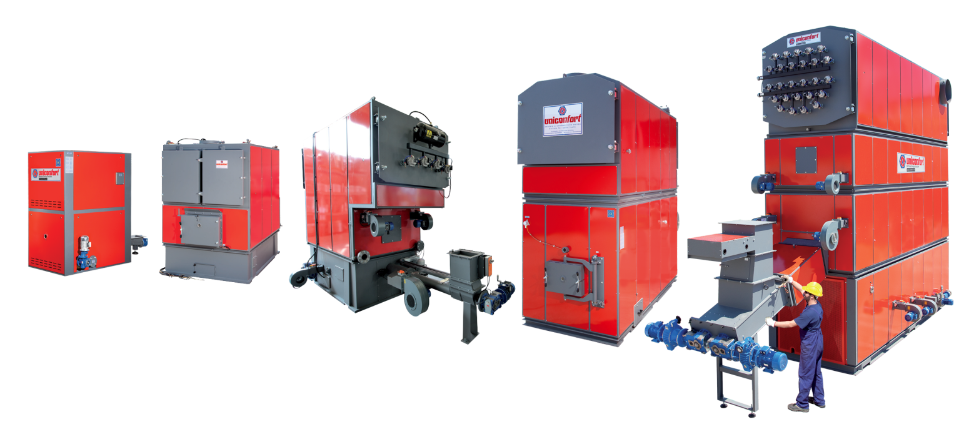
From 60 years, Uniconfort produces boilers which works with forest and woodworking industry waste, agricultural waste, food processing industry waste, dedicated tree and grass crops, cleaning urban landscaping.
THERMAL POWER RANGE: 90 kWt - 25.000 kWt.
ELECTRICAL POWER RANGE: 50 kWe – 5.000 kWe.

Slide 3
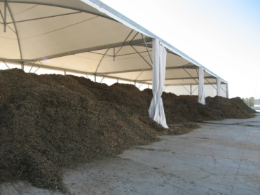
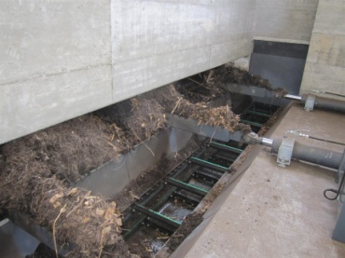
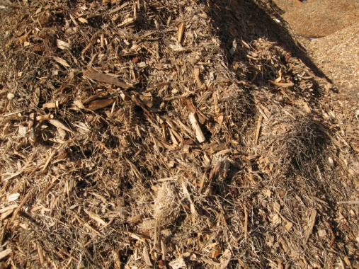
UNICONFORT BOILER works with different kind of solid waste:
YOUR WASTE FOR YOU IS A COST, FOR US IS ENERGY.

Slide 4
2750 Applications all over the world.
SUPERMARKETS
FARMS
GREEN HOUSES
LAUNDRIES
SAWMILLS
STABLES
TOWNS/VILLAGES
HOSPITALS
DISTRICT HEATING
MUSHROOMS CELLS
SCHOOLS
INDUSTRIAL PROCESS
SOME CLIENTS:
-SAINSBURY’S
-GAZPROM
-VEOLIA-DALKIA
-BACARDI
-THE BRITISH RACING SCHOOL

Slide 5
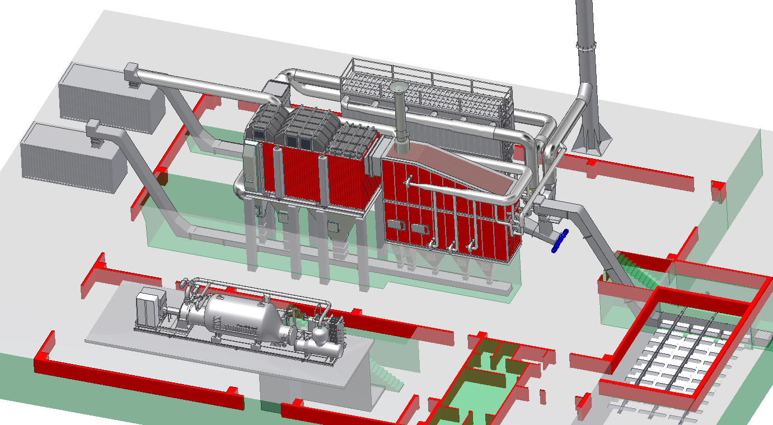
Cogeneration plant
Silo for fuel
Boiler
Smoke treatment
Piping
Turbogenerator
C
C
D
B
A
E

Slide 6
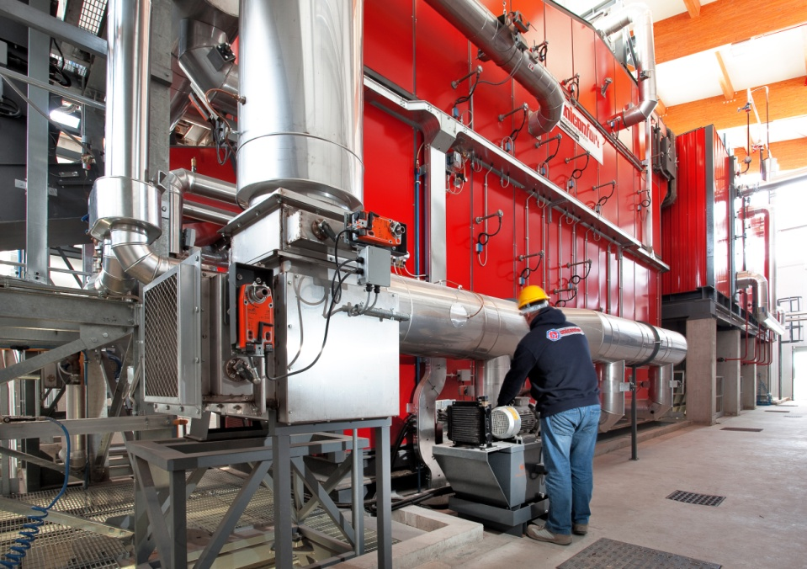
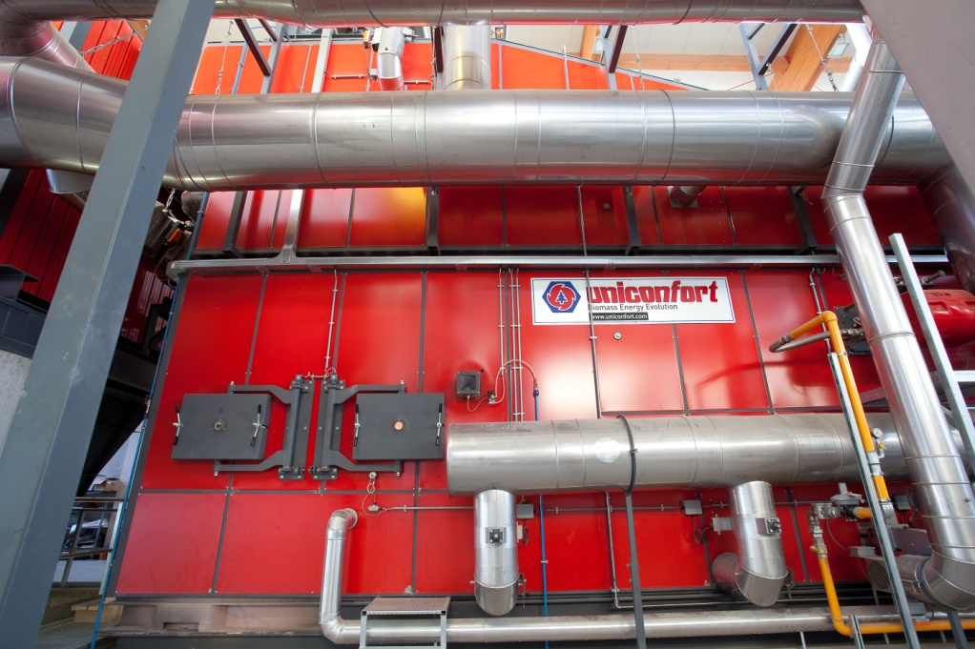
A) 1 MW
Global Boiler | Burning power ≤ 5.5 MW
Electrical Power | 1 MW
Turbine | 4 MW 80°-90°C
Wood-chips | 60% maximum moisture of fuels

Slide 7
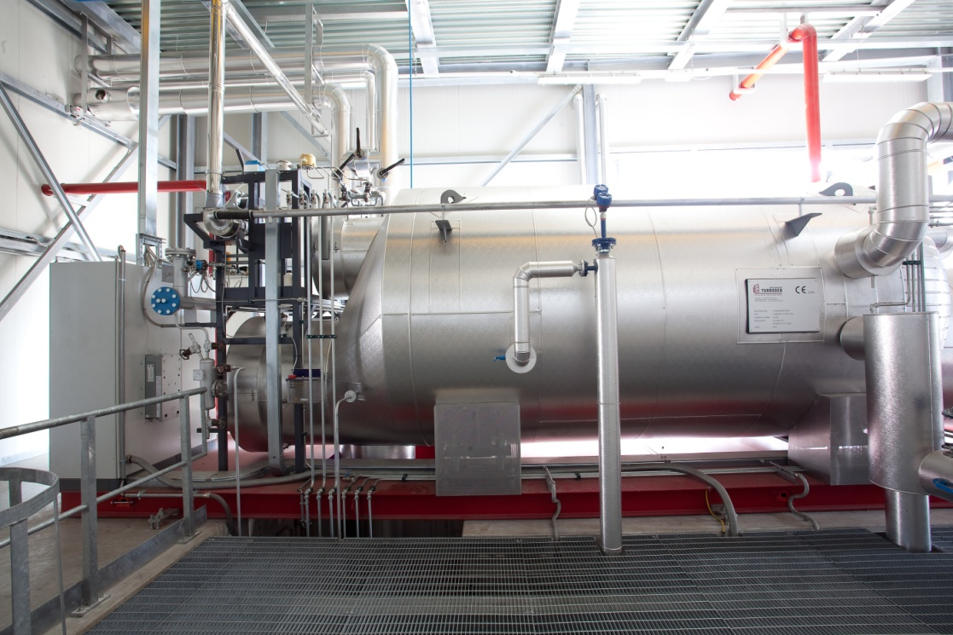
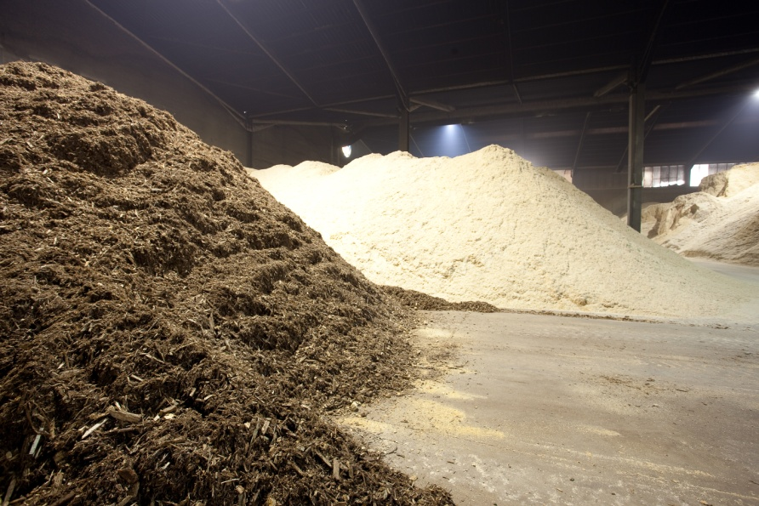

Slide 8
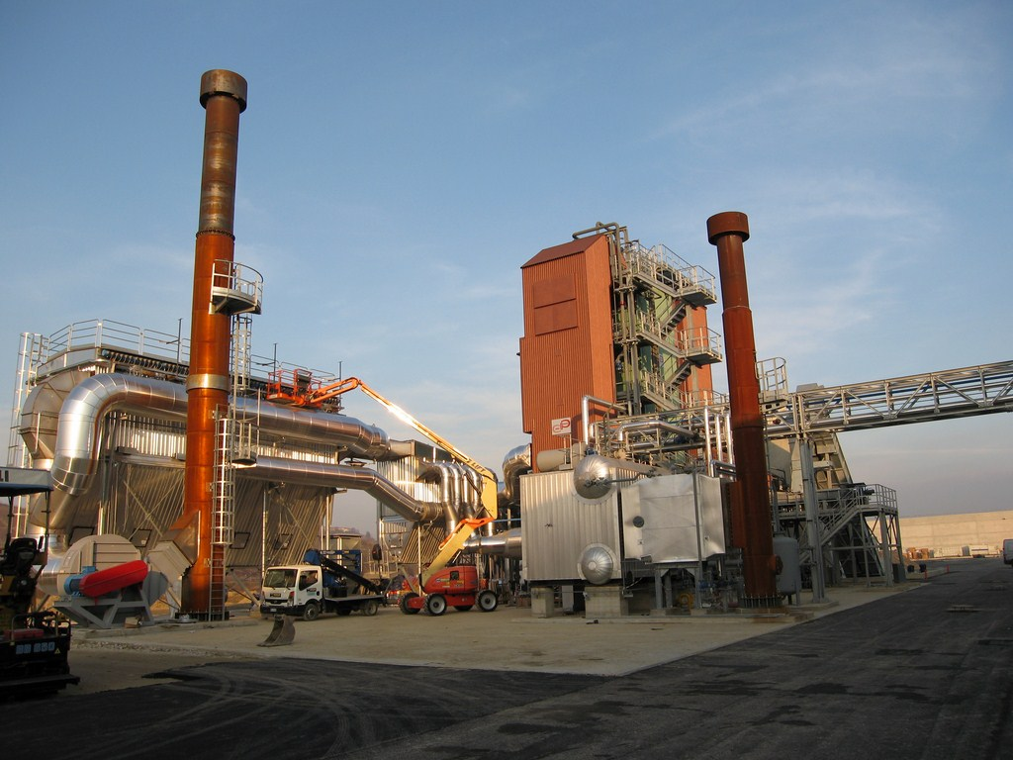
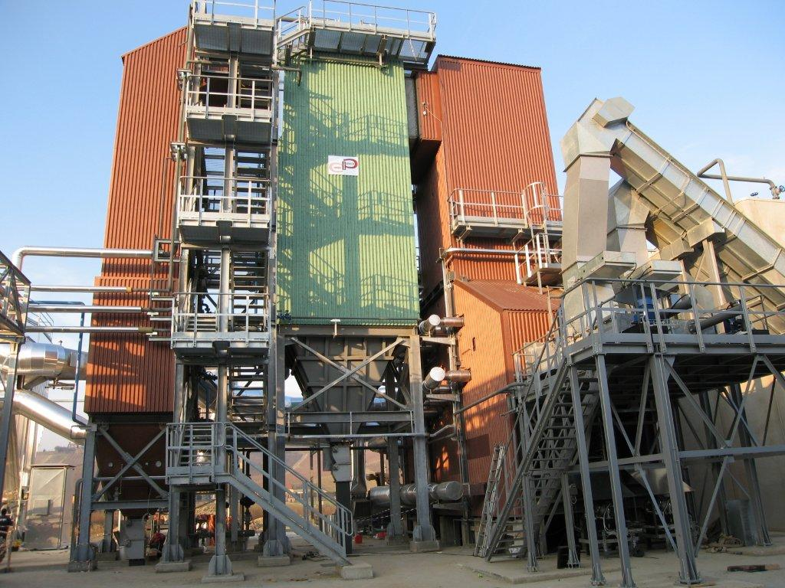
C) 2.5 MW
Global Boiler | Burning power 12 MW
Electrical Power | 2.5 MW
Turbine | Superheated steam
Sawdust, bark | 60% maximum moisture of fuels

Slide 9
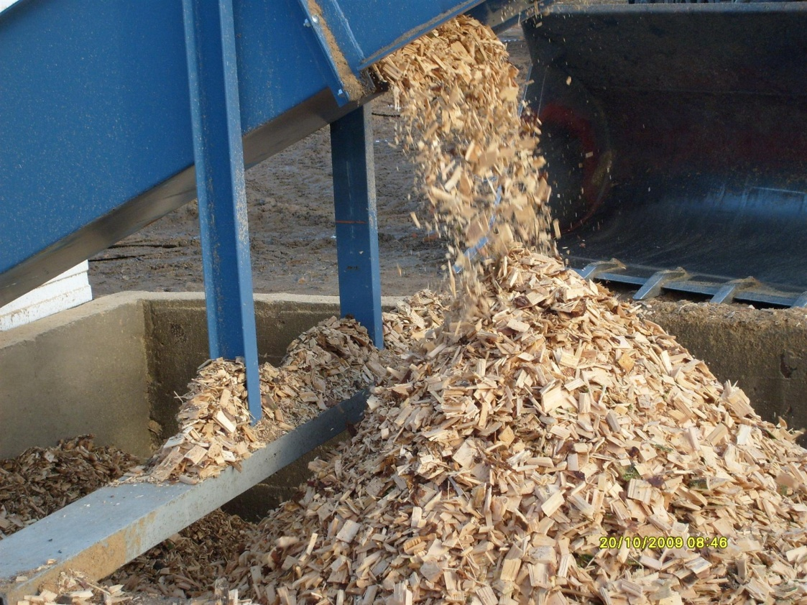
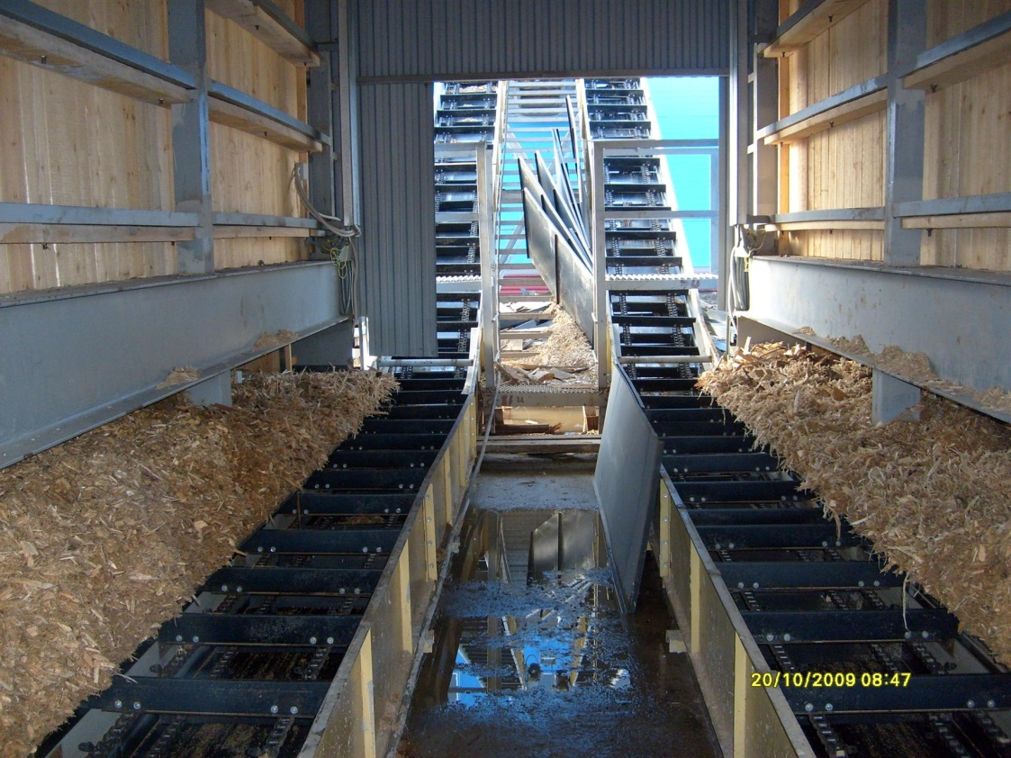

Slide 10
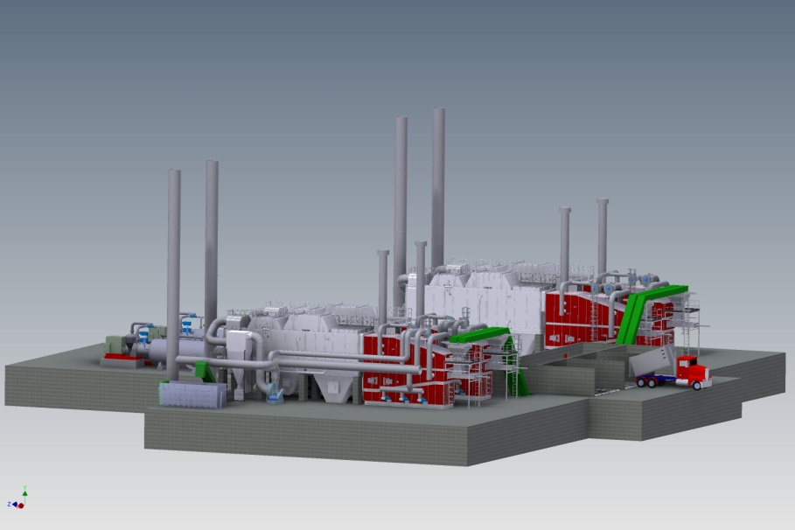
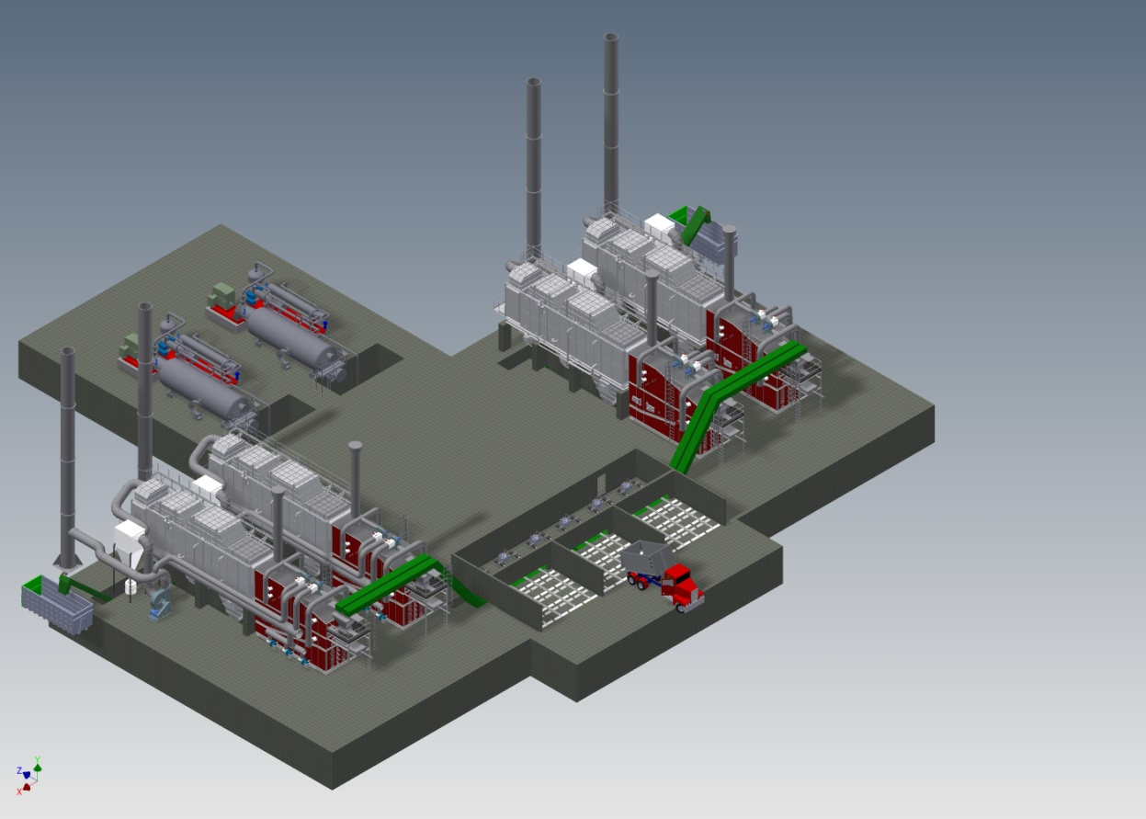
D) 4.4 MW
Global Boilers (4) | Burning power 24 MW
Electrical Power | 4.4 MW
Hot water | 16 MW
Sawdust, bark, woodchips, grinded wood | 60% maximum moisture of fuels

Slide 11
Uniconfort chp references
 | Customer | Power | Fuel | Cogeneration technology
1 | Azienda Agricola “I Leprotti “ Abbiategrasso (MI) | 200 kWe | Wet wood chips | Thermal oil + Turboden ORC group T 200 Split
2 | FIUSIS SRL Calimera (LE) | 1.000 kWe | Olive tree pruning | Thermal oil + Turboden ORC group 12 HRS
3 | SOCIETA’ AGRICOLA “IL QUADRIFOGLIO” Montenero di Bisaccia (CB) | 1.000 kWe | Olive tree pruning, exhausted pomace, Poplar wood chips from Short Rotation | Thermal oil + Turboden ORC group 12 HRS
4 | F.LLI BOSCARO SRL Biella (BI) | 200 Kwe | Recycling material with 12% ash | Superheated water + ORC group Calnetix
5 | ELS ITALIA SRL Tezze sul Brenta (VI) | 1.000 Kwe | Scraps from the sawmill + Poplar wet wood from Short Rotation | Thermal oil + Turboden ORC group T 10 Split

Slide 12
 | Customer | Power | Fuel | Cogeneration technology
6 | Poplar wet wood from Short Rotation | Thermal oil + Turboden ORC group T 10 Split | Scraps from the sawmill, wet bark + Poplar wet wood from Short Rotation | Thermal oil + Turboden ORC group T 10 Split
7 | AZIENDA AGRICOLA IANNUCCI WILLIAM - Bernalda (MT) | 300 Kwe | Olive tree pruning, exhausted pomace, Poplar wood chipd from Short Rotation | Superheated water + ORC group Calnetix
8 | ANTILIA ENERGY WOOD SRL Busca (CN) | 1.000 Kwe | Poplar wet wood SRT | Thermal oil + Turboden ORC group T 1000 Split
9 | PROMETHEUS SOCIETA’ AGRICOLA Cesano Boscone (MI) | 1.000 Kwe | Poplar wet wood from Short Rotation | Thermal oil + Turboden ORC group T 10 Split + Boilers
10 | RICERCHE E SVILUPPO BIOENERGIE SRL Casalmaggiore (CR) | 1.000 Kwe |  | Thermal oil + Turboden ORC group T 10 Split

Slide 13
 | Customer | Power | Fuel | Cogeneration technology
11 | AGRIENERGIA SAN BENEDETTO DEL PO’ SRL San Benedetto Po (MN) | 1000 Kwe | Poplar wet wood from Short Rotation | Thermal oil + Turboden ORC group T 10 Split
12 | VERITAS SPA Municipalizzata Comune di Venezia, Mestre (VE) | 300Kwe | Wood material from separate collection of municipal wastes | External combustion turbine Turbek
13 | BRITISH RACING SCHOOL (BRS) - England | 100 Kwe | 70% straw + 30% sawdust | Superheated water with GE technology
14 | AGDS Cedeira - Spain | 1000Kwe | Wet wood chips | Thermal oil + Turboden ORC group 12 HRS
15 | EPICO Cittaducale (RI) | 1000 Kwe | Scraps from different pruning | Thermal oil + Turboden ORC group 12 HRS
16 | LODI ENERGIA Lodi (LO) | 1000 Kwe | Wood chips + Mix of biogas digestate | Thermal oil + Turboden ORC group T 14 Split

Slide 14
 | Customer | Power | Fuel | Cogeneration technology
17 | AGO ENERGIA Santa Luce (PI) | 1000 Kwe | Forest chips | Thermal oil + Turboden ORC group T 10 Split
18 | VIGOLUNGO S.P.A. Canale (CN) | 3000 Kwe | Wet scraps from sawmill | Steam turbine
19 | ACUTE ENNISKILLEN HOSPITAL Ireland | 400 Kwe | Pellet | Saturated steam with Spilling technology
20 | BASINGSTOKE SKIP HIRE LTD England | 600 Kwe | Wood chips | Superheated water 150°C
21 | SKYLAB Torino (TO) | 1000Kwe | Wet poplar wood chips | Thermal oil + Turboden ORC group T 1000 Split
22 | LA TIESSE Cimadolmo (TV) | 1000 kWe | Recycling material with 12% ash | Thermal oil + Turboden ORC group T 10 Split

Slide 15
 | Customer | Power | Fuel | Cogeneration technology
23 | ENERGIA VULTURE ALTO BRADANO SRL Venosa (PZ) | 1000 kWe 3900 kWt | Olive waste, olive prunning | Thermal oil + Turboden ORC group Energy 1000
24 | Eco Energy Bulgaria | 1000 kWe | Wet wood chips | Thermal oil + Turboden ORC
25 | MLINOTEST Slovenia | 150 kWe | Wet Wood chips | Spilling
26 | ZASOLI | 200 kWe | Waste Material | Mixed cycle: steam and superheated water
27 | TERRAMARE | 200 kWe | Waste material | Mixed cycle: steam and superheated water
28 | RINNOVA ENERGIA Sospiro (CR) | 1000 Kwe | Wet poplar wood chips | Thermal oil + Turboden ORC group T 1000 Split

Slide 16
 | Customer | Power | Fuel | Cogeneration technology
28 | GAZPROM Severognesk- Russia | 1.000 kWe | Wet wood chips | Thermal oil with ORC (Turboden) , in Order, plant will be ready in 2016
29 | SOLIS Settimo Torinese (TO) | 1.000 kWe | Wet wood chips material | Thermal oil + Turboden ORC group T 10 Split
30 | PRALAFERA Luserna San Giovanni (TO) | 1.000 kWe | Wet wood chips material | Thermal oil + Turboden ORC group T 10 Split
31 | LEDRO ENERGIA Tiano di Sopra (TN) | 300 kWe | Wet wood chips material and sawdust | Thermal oil + Turboden ORC group T 7
32 | SO.SV.A.V. Ponte di Legno (BS) | 720 kWe | Wet wood chips material | Flue Gas 850°C + Turboden ORC group TD 3

Slide 17
Uniconfort Srl
Via dell’industria, 21 San Martino di Lupari, Padova
35018 Italy
info@uniconfort.com www.uniconfort.com

